Slide 1
Games Bootcamp Design, UI & Scripting

Slide 2
Recap
Game Genres & Design Considerations.

Slide 3
Table of contents
01
Design Principles
04
Tasks
02
User Interface (UI)
03
Scripting Basics C#
Extra considerations
Practical tasks to help you practice the concepts
Concepts & Considerations
Introducing coding.

Slide 4
02
User Interface (UI)
visual elements used to interact with and navigate the game, such as menus, health bars, score displays, and buttons.

Slide 5
User Interface Considerations
Clarity
User-Friendly
Functionality
Should be simple & uncluttered
Should use clear fonts with good contrasting colors
Navigation should be logical.

Slide 6

Hierarchy & Theme
What needs my attention?
What is distracting?

Slide 7
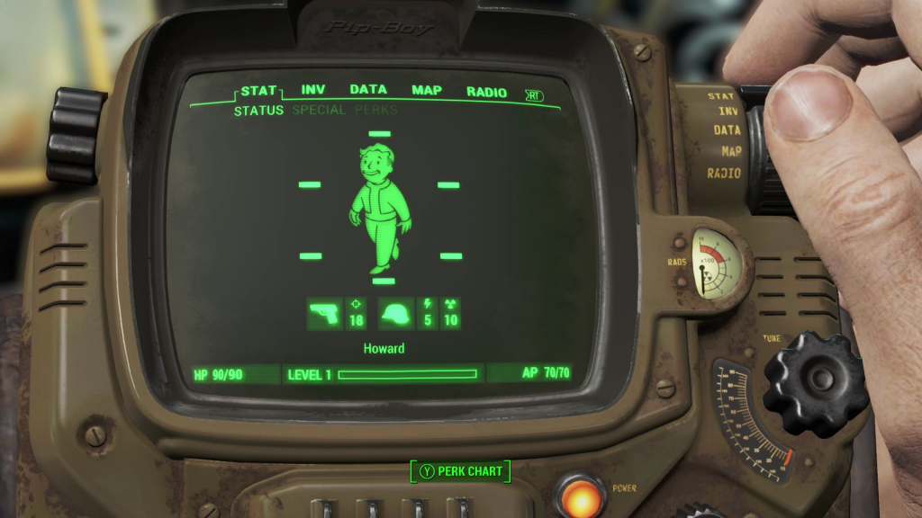
Hierarchy & Theme

Slide 8
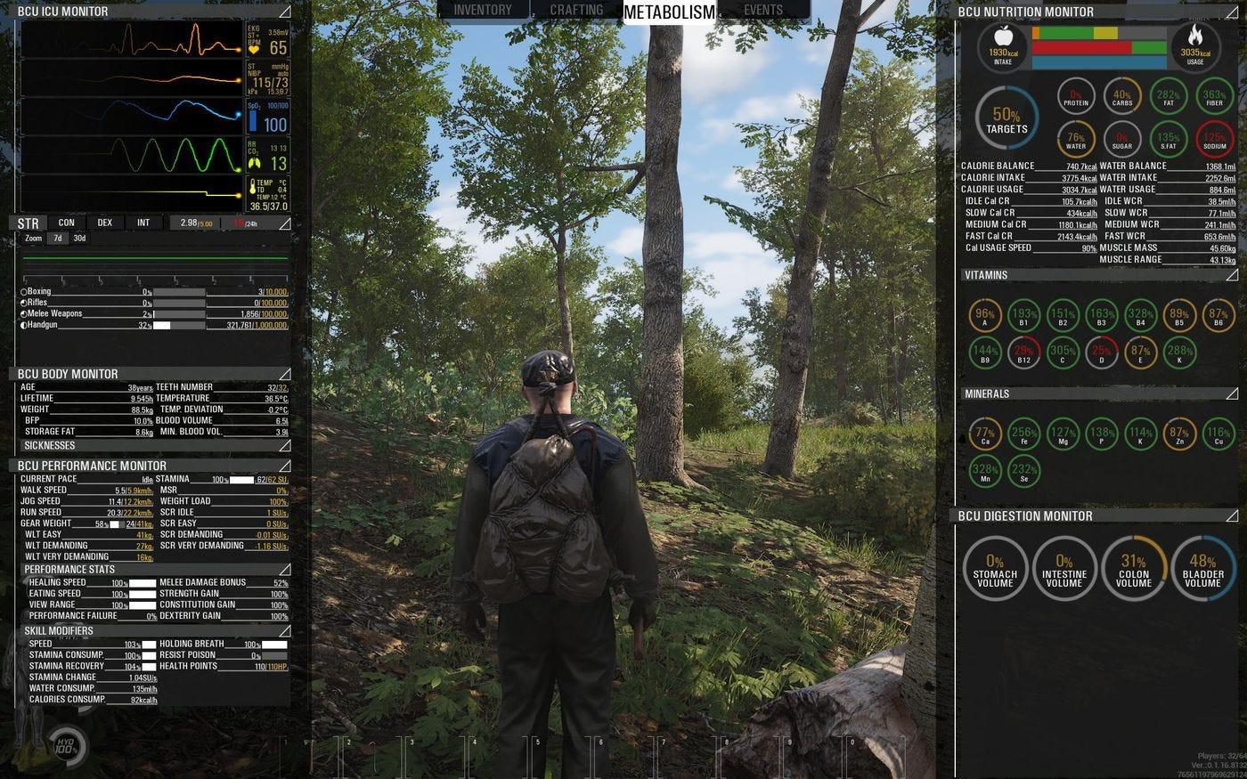
Hierarchy & Theme

Slide 9
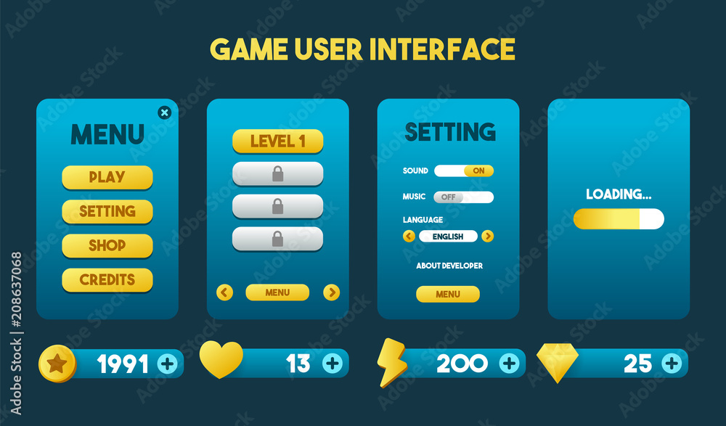
Hierarchy & Theme

Slide 10

Iconography
Icons should be recognisable
Should maintain visual theme

Slide 11
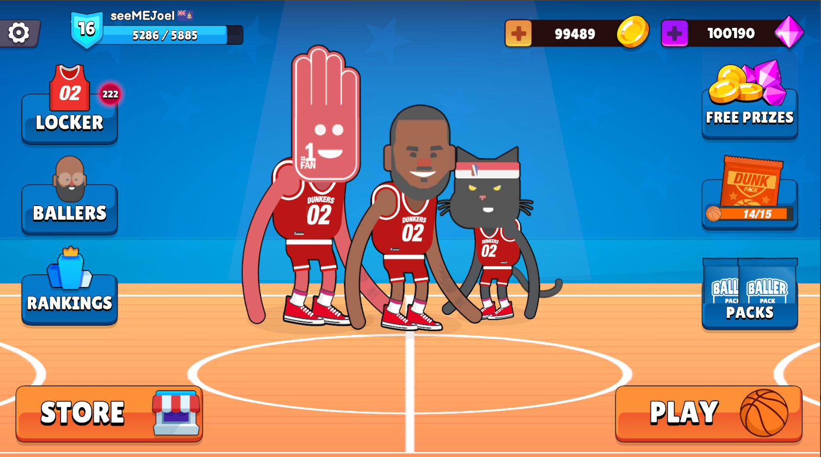
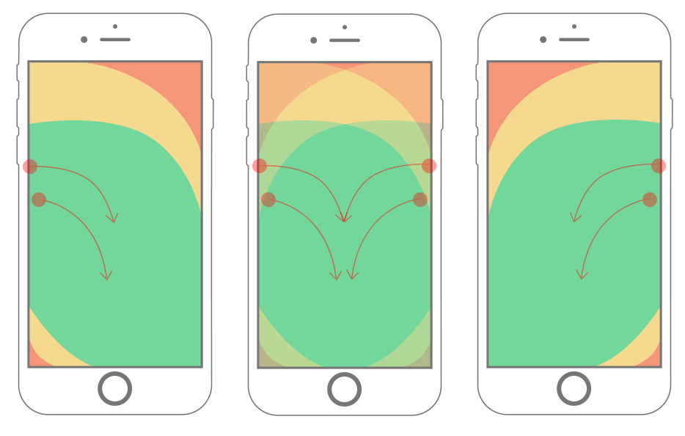
Mobile Game UI
Less screen space
Touch friendly
Feedback

Slide 12
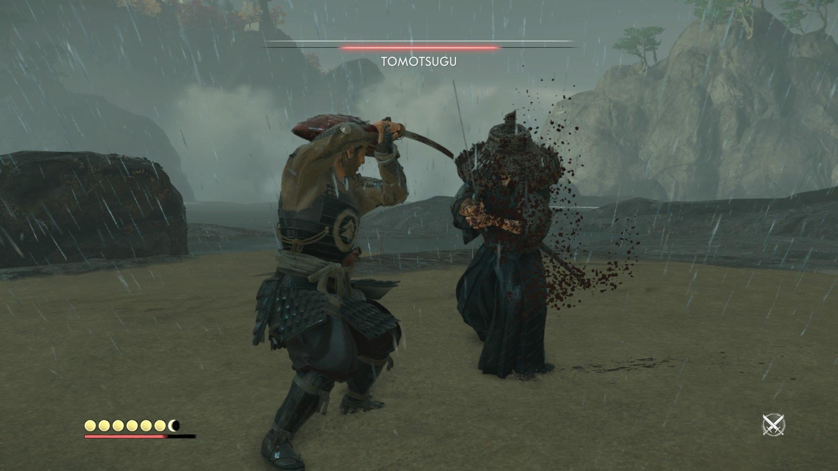
Console/PC UI
Big screen
Controller Input
More detail
Contextual Awareness

Slide 13
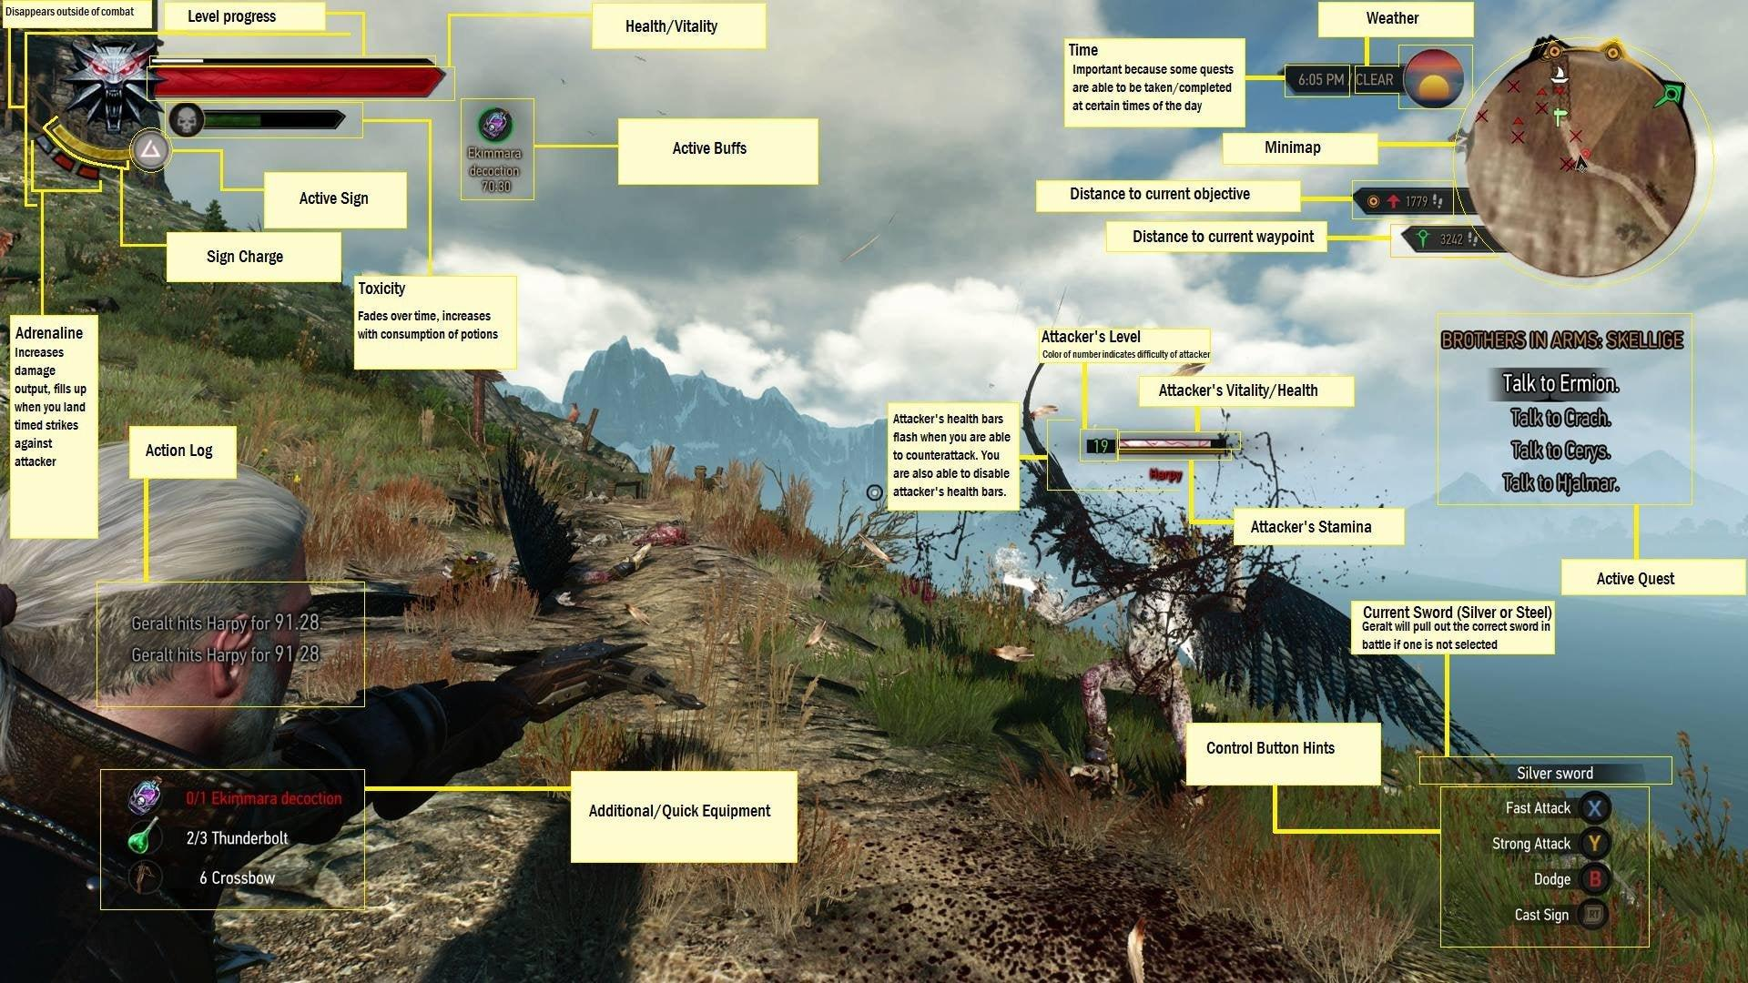

Slide 14
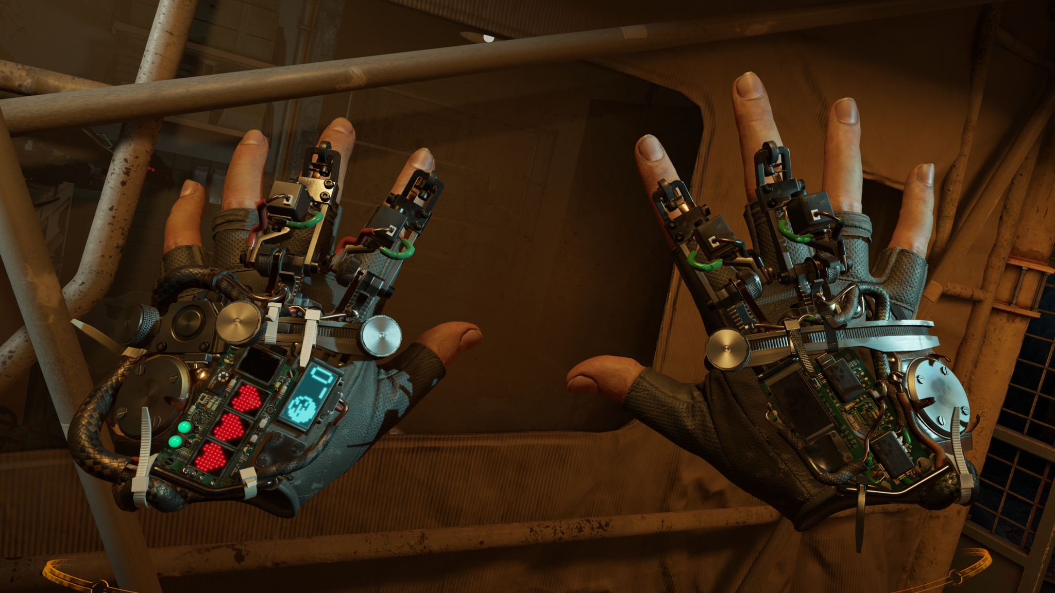
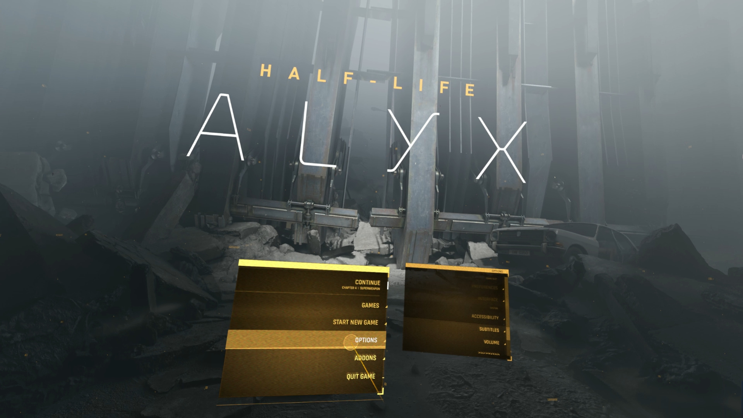
VR/AR
Floating panels
VR Controllers
Use of environment

Slide 15
03
Scripting Basics C#
You can enter a subtitle here if you need it

Slide 16
Topics to Cover
Scripts
Types & Fields
Visual Studio
Debug
Unity Basics
Maths
What is script?
Core Concepts
Introduction
How to test things
What does it all mean?
How to start changing things.
Notes:
Scripting Basics C#
A component that defines the logic or behaviour of a GameObject.
Core Concept
Data Types & Fields
public vs private
VS Color scheme
Blue: reserved keywords | Pink: conditionals/loops/branches | Teal: Types / Classes | Yellow: user-defined functions | Orange: string literals | Green: comments | Pale Green: structs
Console debugging
Start vs Update
Simple Operations.
Solar System Game:
Demonstrate hierarchy rotation, point lighting, skybox.
Input System:
Legacy System: Input.KeyDown
New System: Input Action
Touch Controls using legacy system

Slide 17
Recap

